Slide 1
Final Thoughts
AI2C Tech Intro

Slide 2
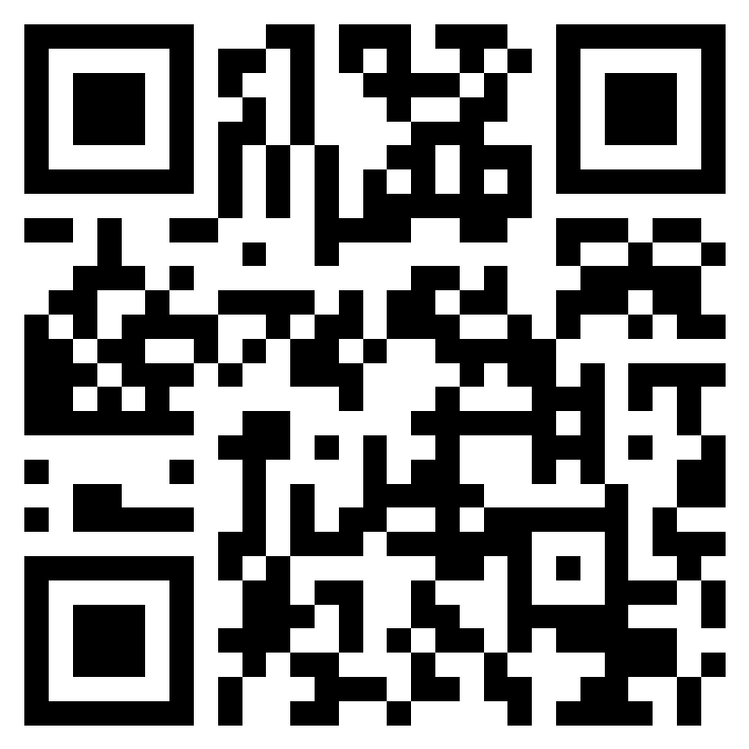
AAR
https://forms.office.com/r/RvNFP3m9Ck
Open until 1900 on 22-Aug-25

Slide 3
Friday

